Slide 1
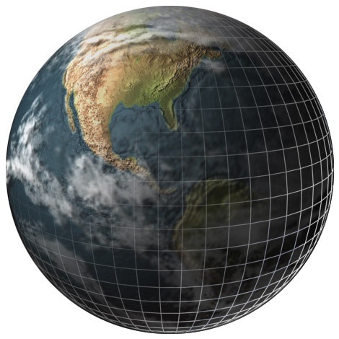
Prentice Hall EARTH SCIENCE
Tarbuck Lutgens
◆

Slide 2
Chapter
25
Beyond Our
Solar System
Notes:
Who is Stan Hatfield and Ken Pinzke

Slide 3
25.1 Properties of Stars
Characteristics of Stars
A constellation is an apparent group of stars originally named for mythical characters. The sky contains 88 constellations.
◆ Star Color and Temperature
• Color is a clue to a star’s temperature.

Slide 4
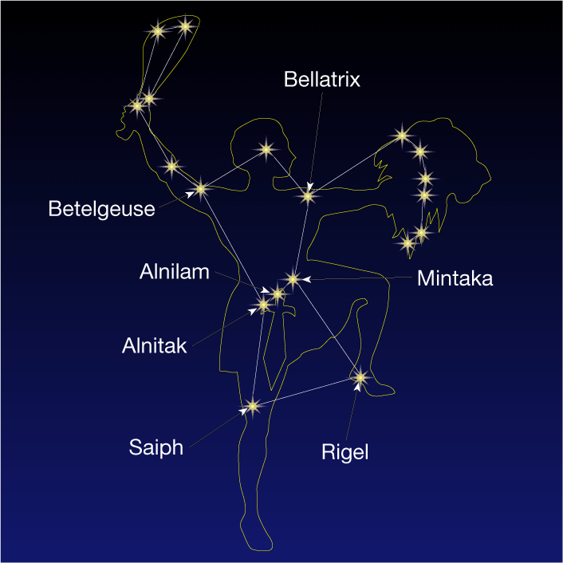
The Constellation Orion
Notes:
Makes no sense without caption in book

Slide 5
25.1 Properties of Stars
Characteristics of Stars
◆ Binary Stars and Stellar Mass
• A binary star is one of two stars revolving around a common center of mass under their mutual gravitational attraction.
• Binary stars are used to determine the star property most difficult to calculate—its mass.

Slide 6
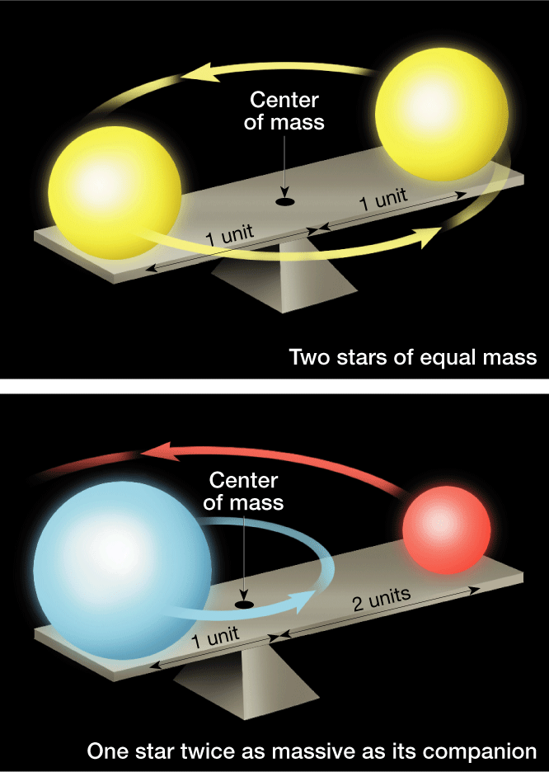
Common Center of Mass
Notes:
Makes no sense without caption in book

Slide 7
25.1 Properties of Stars
Measuring Distances to Stars
◆ Parallax
• Parallax is the slight shifting of the apparent position of a star due to the orbital motion of Earth.
• The nearest stars have the largest parallax angles, while those of distant stars are too small to measure.
◆ Light-Year
• A light-year is the distance light travels in a year, about 9.5 trillion kilometers.

Slide 8
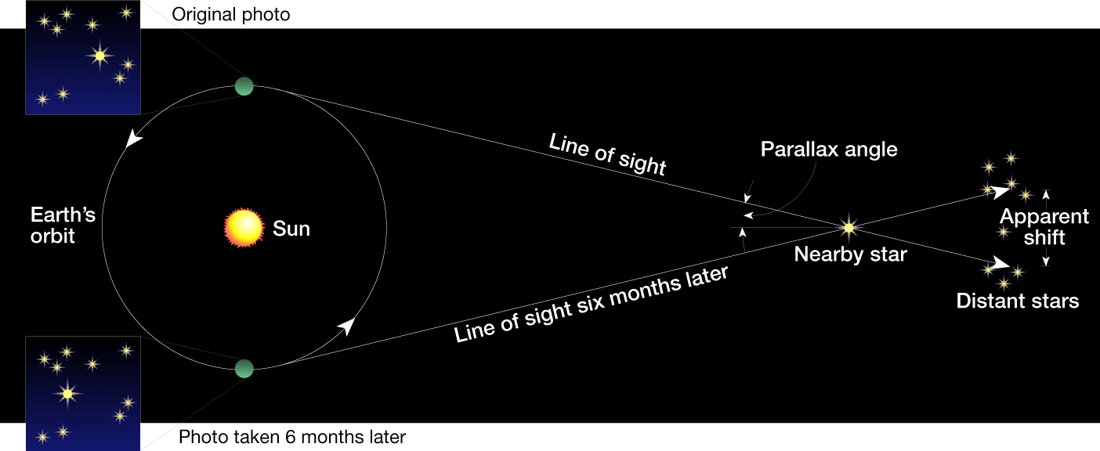
Parallax
Original Photo
Photo taken 6 months later
Notes:
Makes no sense without caption in book

Slide 9
25.1 Properties of Stars
Stellar Brightness
◆ Apparent Magnitude
• Apparent magnitude is the brightness of a star when viewed from Earth.
• Three factors control the apparent brightness of a star as seen from Earth: how big it is, how hot it is, and how far away it is.
◆ Absolute Magnitude
• Absolute magnitude is the apparent brightness of a star if it were viewed from a distance of 32.6 light-years.

Slide 10
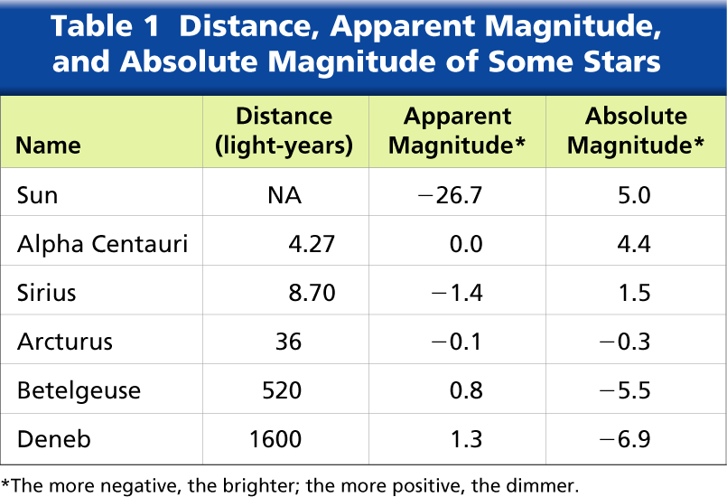
Distance, Apparent Magnitude, and Absolute Magnitude of Some Stars
Notes:
Makes no sense without caption in book

Slide 11
25.1 Properties of Stars
Hertzsprung–Russell Diagram
◆ A Hertzsprung–Russell diagram shows the relationship between the absolute magnitude and temperature of stars.
◆ A main-sequence star is a star that falls into the main sequence category on the H–R diagram. This category contains the majority of stars and runs diagonally from the upper left to the lower right on the H–R diagram.

Slide 12
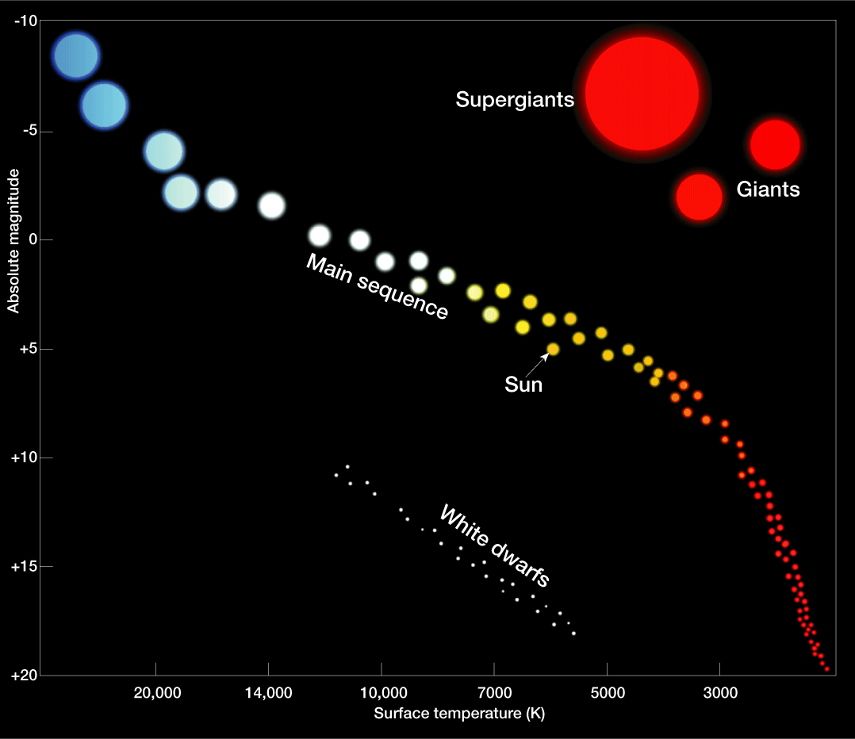
Hertzsprung–Russell Diagram
Notes:
Makes no sense without caption in book

Slide 13
25.1 Properties of Stars
Hertzsprung–Russell Diagram
◆ A red giant is a large, cool star of high luminosity; it occupies the upper-right portion of the H–R diagram.
◆ A supergiant is a very large, very bright red giant star.

Slide 14
25.1 Properties of Stars
Hertzsprung–Russell Diagram
◆ Variable Stars
• A Cepheid variable is a star whose brightness varies periodically because it expands and contracts; it is a type of pulsating star.
• A nova is a star that explosively increases in brightness.

Slide 15
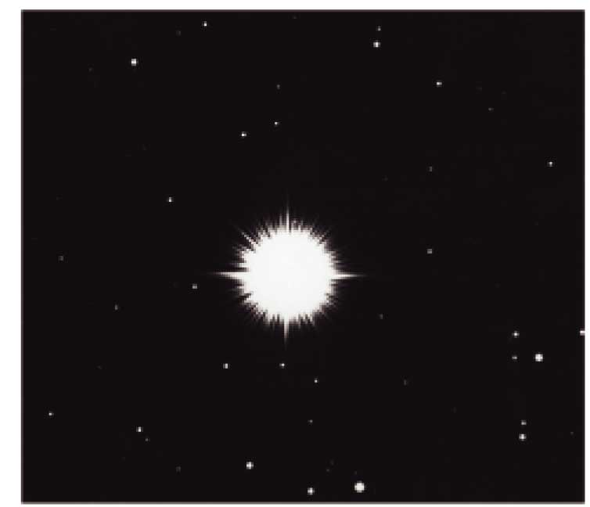
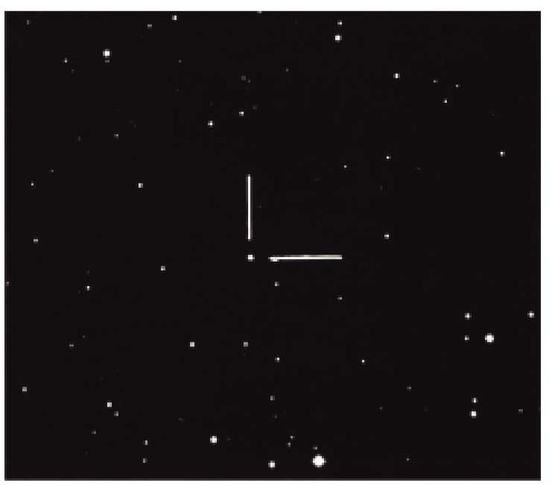
Images of a Nova Taken
Two Months Apart
Notes:
Makes no sense without caption in book

Slide 16
25.1 Properties of Stars
Hertzsprung–Russell Diagram
◆ Interstellar Matter
• A nebula is a cloud of gas and/or dust in space.
• There are two major types of nebulae:
1. Bright nebula
- Emission nebula
- Reflection nebula
2. Dark nebula

Slide 17
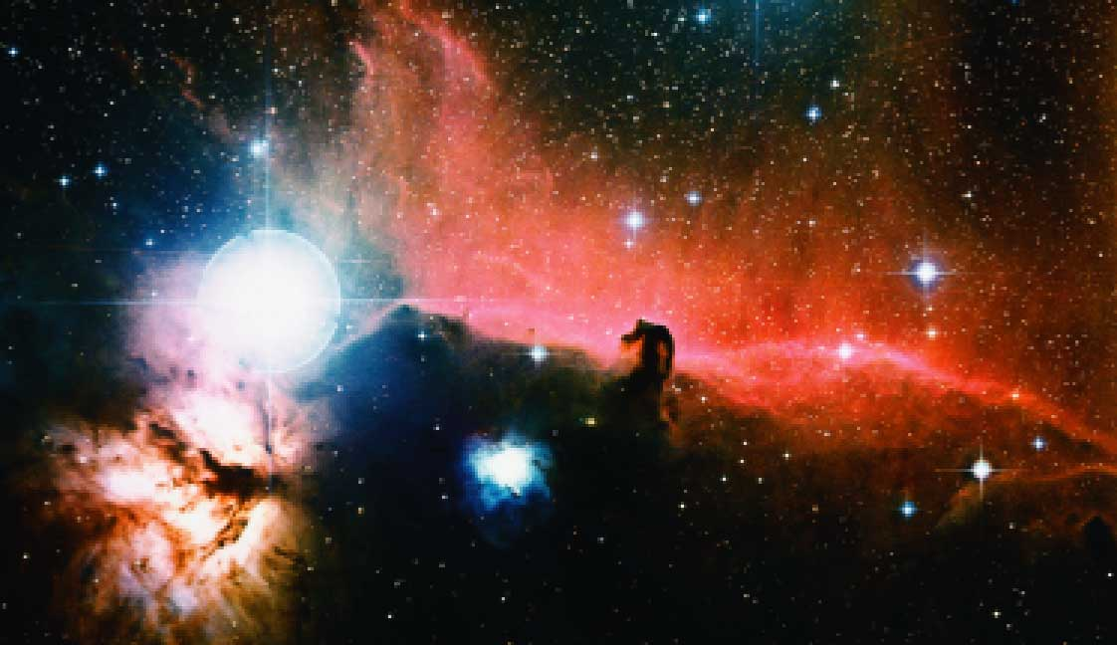
Interstellar Matter
Notes:
Makes no sense without caption in book

Slide 18
25.2 Stellar Evolution
Star Birth
◆ Protostar Stage
• A protostar is a collapsing cloud of gas and dust destined to become a star—a developing star not yet hot enough to engage in nuclear fusion.
• When the core of a protostar has reached about 10 million K, pressure within is so great that nuclear fusion of hydrogen begins, and a star is born.

Slide 19
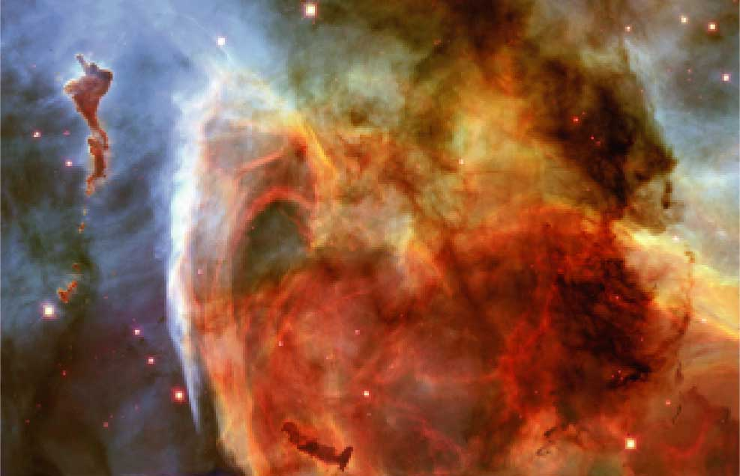
Nebula, Birthplace of Stars
Notes:
Makes no sense without caption in book

Slide 20
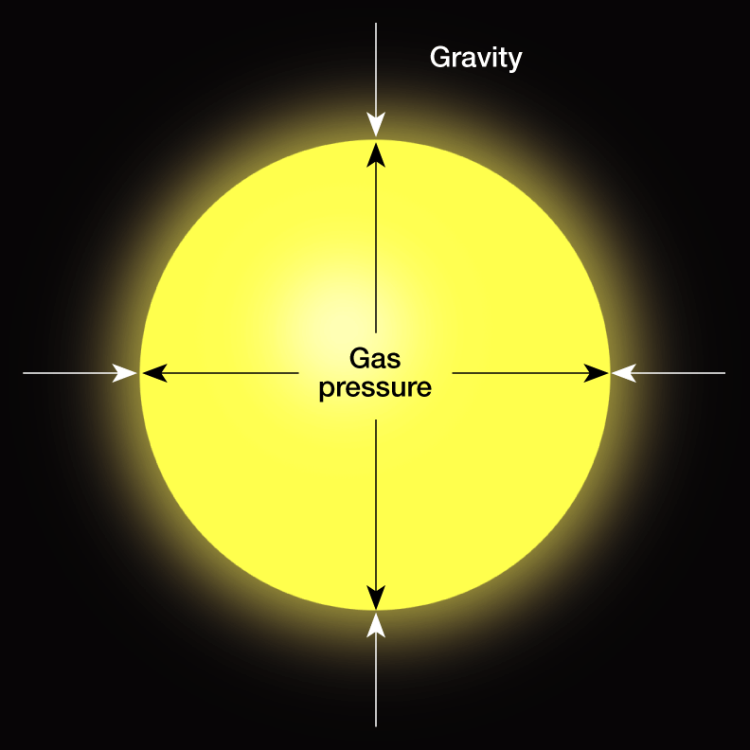
Balanced Forces
Notes:
Makes no sense without caption in book

Slide 21
25.2 Stellar Evolution
Star Birth
◆ Main-Sequence Stage
• Stars age at different rates.
- Massive stars use fuel faster and exist for only a few million years.
- Small stars use fuel slowly and exist for perhaps hundreds of billions of years.
• A star spends 90 percent of its life in the main-sequence stage.

Slide 22
25.2 Stellar Evolution
Star Birth
◆ Red-Giant Stage
• Hydrogen burning migrates outward. The star’s outer envelope expands.
• Its surface cools and becomes red.
• The core collapses as helium is converted to carbon. Eventually all nuclear fuel is used and gravity squeezes the star.

Slide 23
25.2 Stellar Evolution
Burnout and Death
◆ All stars, regardless of their size, eventually run out of fuel and collapse due to gravity.
◆ Death of Low-Mass Stars
• Stars less than one-half the mass of the sun never evolve to the red giant stage but remain in the stable main-sequence stage until they consume all their hydrogen fuel and collapse into a white dwarf.

Slide 24
25.2 Stellar Evolution
Burnout and Death
◆ Death of Medium-Mass Stars
• Stars with masses similar to the sun evolve in essentially the same way as low-mass stars.
• During their collapse from red giants to white dwarfs, medium-mass stars are thought to cast off their bloated outer layer, creating an expanding round cloud of gas called planetary nebula.

Slide 25
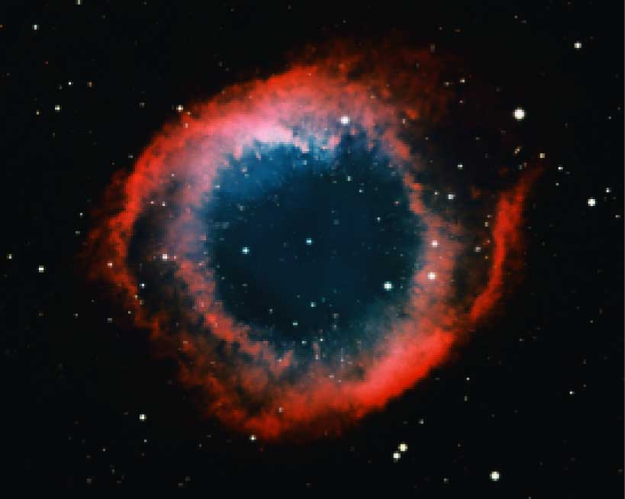
Planetary Nebula
Notes:
Makes no sense without caption in book

Slide 26
25.2 Stellar Evolution
Burnout and Death
◆ Death of Massive Stars
• In contrast to sunlike stars, stars that are over three times the sun’s mass have relatively short life spans, which end in a supernova event.
A supernova is an exploding massive star that increases in brightness many thousands of times.
The massive star’s interior condenses and may produce a hot, dense object that is either a neutron star or a black hole.

Slide 27
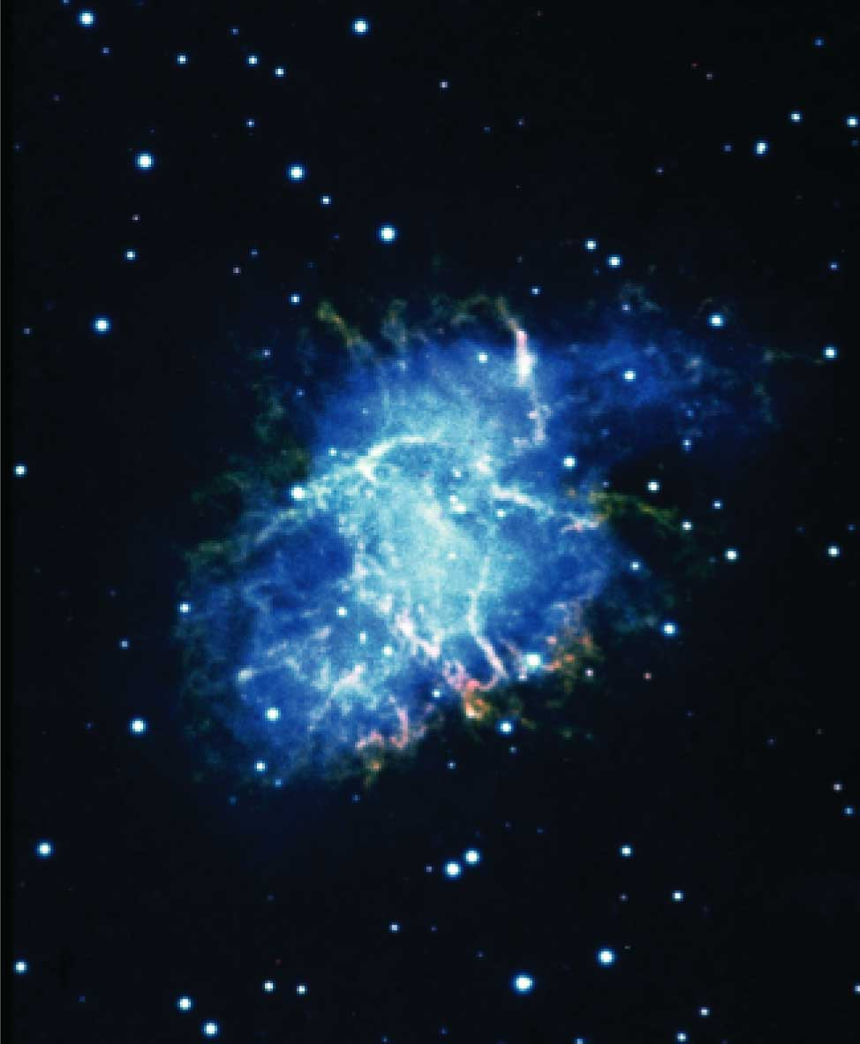
Crab Nebula in the
Constellation Taurus
Notes:
Makes no sense without caption in book

Slide 28
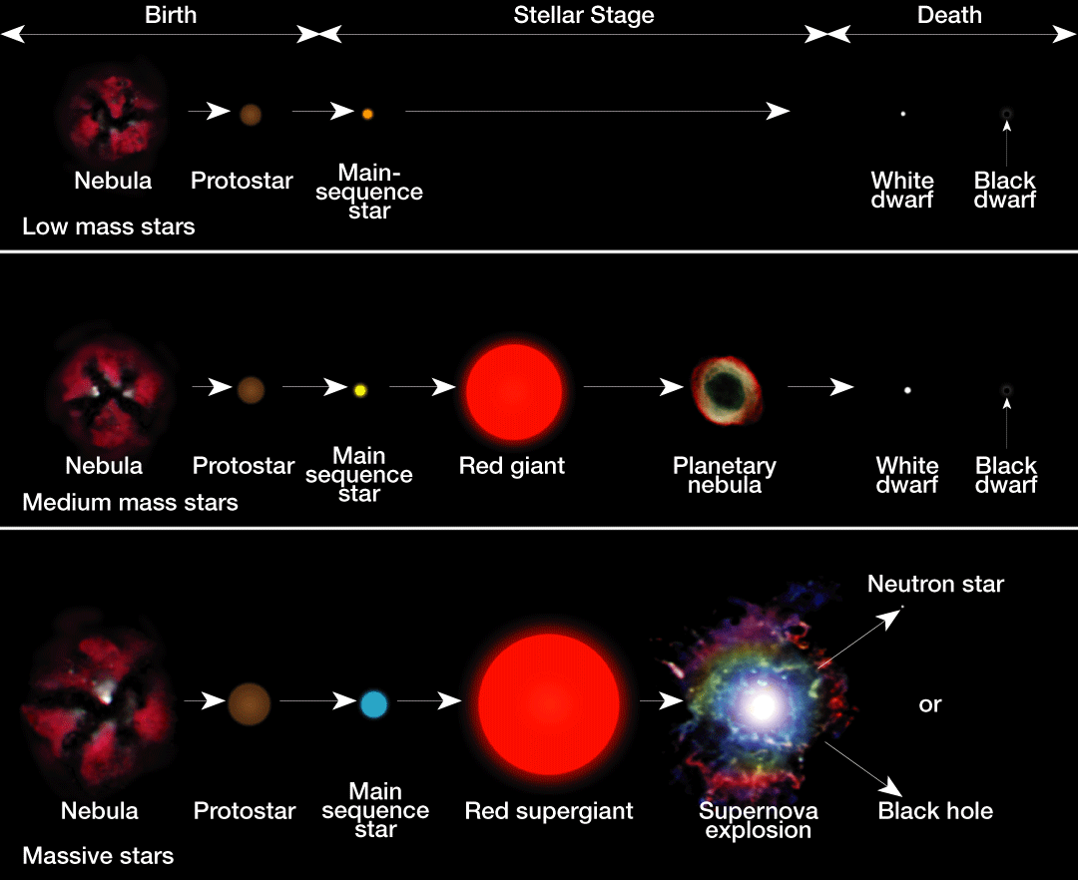
Stellar Evolution
Notes:
Makes no sense without caption in book

Slide 29
25.2 Stellar Evolution
Burnout and Death
◆ H–R Diagrams and Stellar Evolution
• Hertzsprung–Russell diagrams have been helpful in formulating and testing models of stellar evolution.
• They are also useful for illustrating the changes that take place in an individual star during its life span.

Slide 30
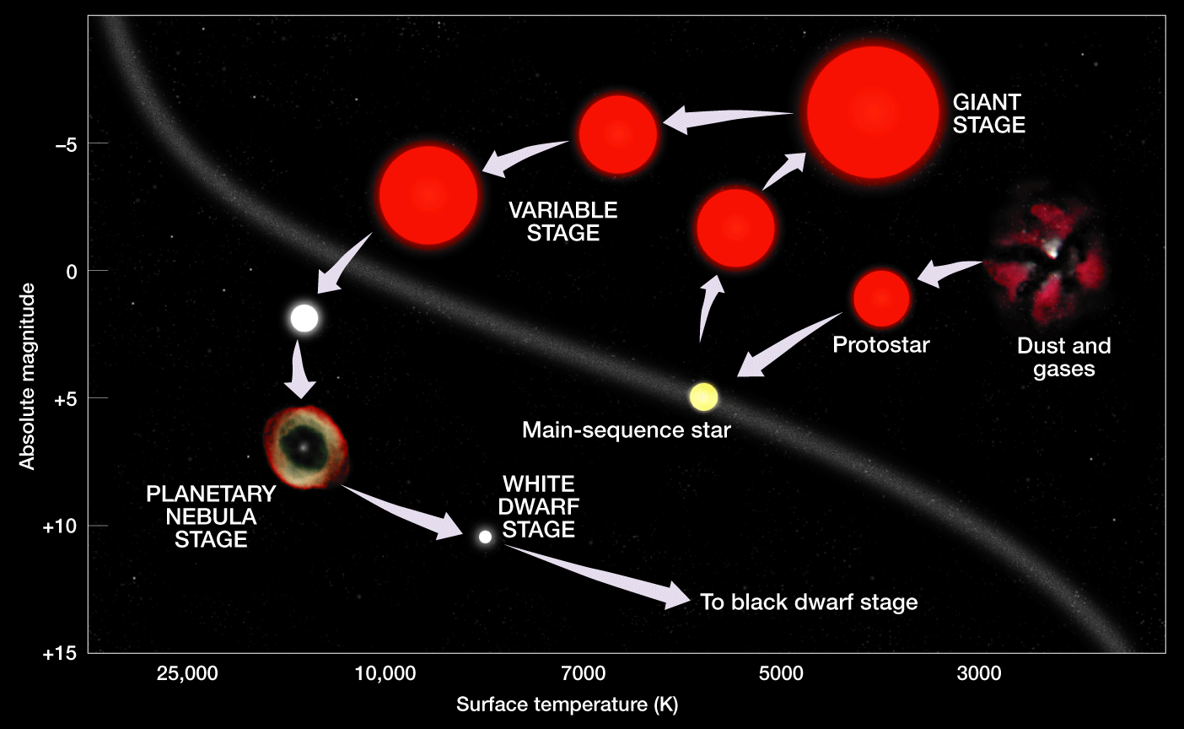
Life Cycle of a Sunlike Star
Notes:
Makes no sense without caption in book

Slide 31
25.2 Stellar Evolution
Stellar Remnants
◆ White Dwarfs
• A white dwarf is a star that has exhausted most or all of its nuclear fuel and has collapsed to a very small size, believed to be near its final stage of evolution.
• The sun begins as a nebula, spends much of its life as a main-sequence star, and then becomes a red giant, a planetary nebula, a white dwarf, and, finally, a black dwarf.

Slide 32
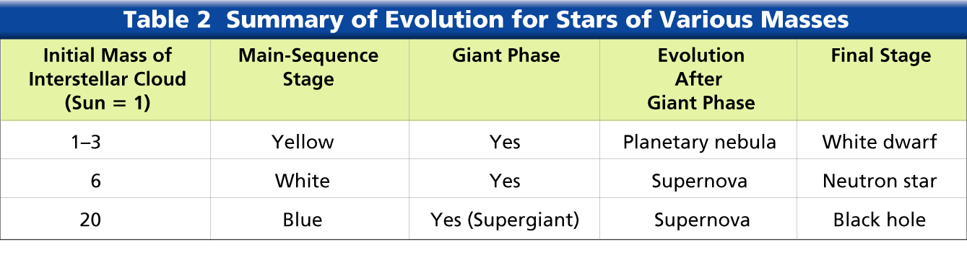
Summary of Evolution for
Stars of Various Masses
Notes:
Makes no sense without caption in book

Slide 33
25.2 Stellar Evolution
Stellar Remnants
◆ Neutron Stars
• A neutron star is a star of extremely high density composed entirely of neutrons.
• Neutron stars are thought to be remnants of supernova events.
◆ Supernovae
• A pulsar is a source that radiates short bursts or pulses of radio energy in very regular periods.
• A pulsar found in the Crab Nebula during the 1970s is undoubtedly the remains of the supernova of 1054.

Slide 34
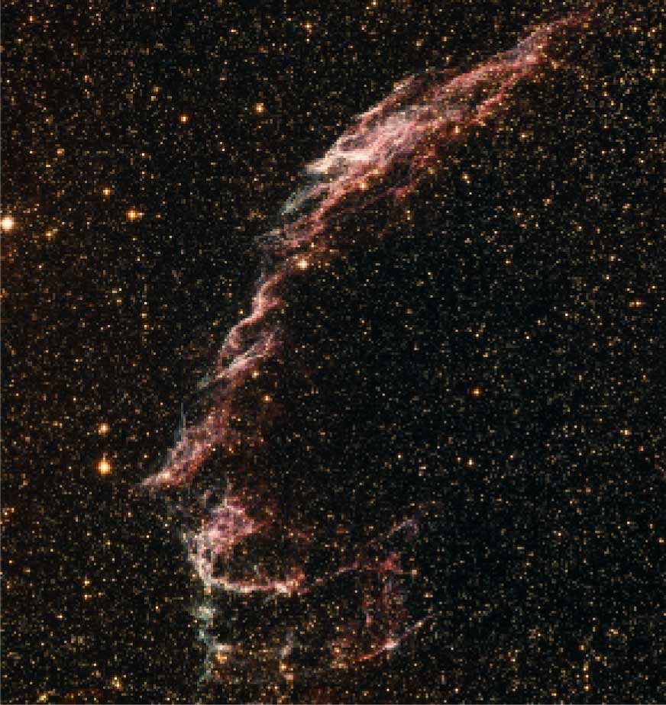
Veil Nebula in the Constellation Cygnus
Notes:
Makes no sense without caption in book

Slide 35
25.2 Stellar Evolution
Stellar Remnants
◆ Black Holes
• A black hole is a massive star that has collapsed to such a small volume that its gravity prevents the escape of everything, including light.
Scientists think that as matter is pulled into a black hole, it should become very hot and emit a flood of X-rays before being pulled in.

Slide 36
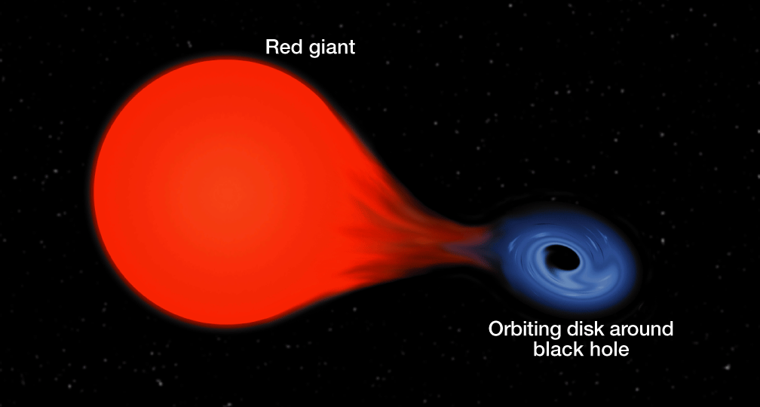
Black Hole
Notes:
Makes no sense without caption in book

Slide 37
25.3 The Universe
The Milky Way Galaxy
◆ A galaxy is a group of stars, dust, and gases held together by gravity.
◆ Size of the Milky Way
• The Milky Way is a large spiral galaxy whose disk is about 100,000 light-years wide and about 10,000 light-years thick at the nucleus.
◆ Structure of the Milky Way
• Radio telescopes reveal that the Milky Way has at least three distinct spiral arms, with some splintering.

Slide 38
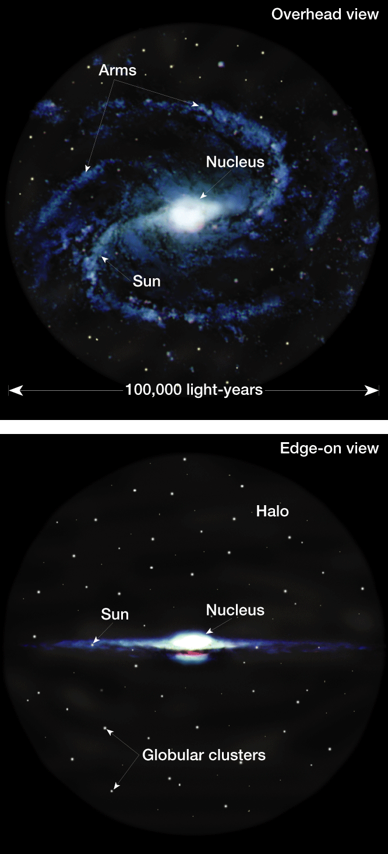
Structure of the Milky Way
Notes:
Makes no sense without caption in book

Slide 39
25.3 The Universe
Types of Galaxies
◆ Spiral Galaxies
• About 30 percent of all galaxies are spiral galaxies.
• They have large diameters of 20,000 to 125,000 light-years and contain both young and old stars.
◆ Elliptical Galaxies
• About 60 percent of galaxies are classified as elliptical galaxies.
• Elliptical galaxies range in shape from round to oval.

Slide 40
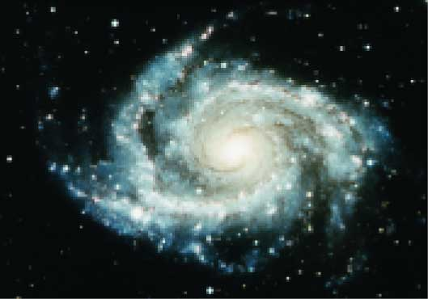
Spiral Galaxies
Notes:
Makes no sense without caption in book

Slide 41
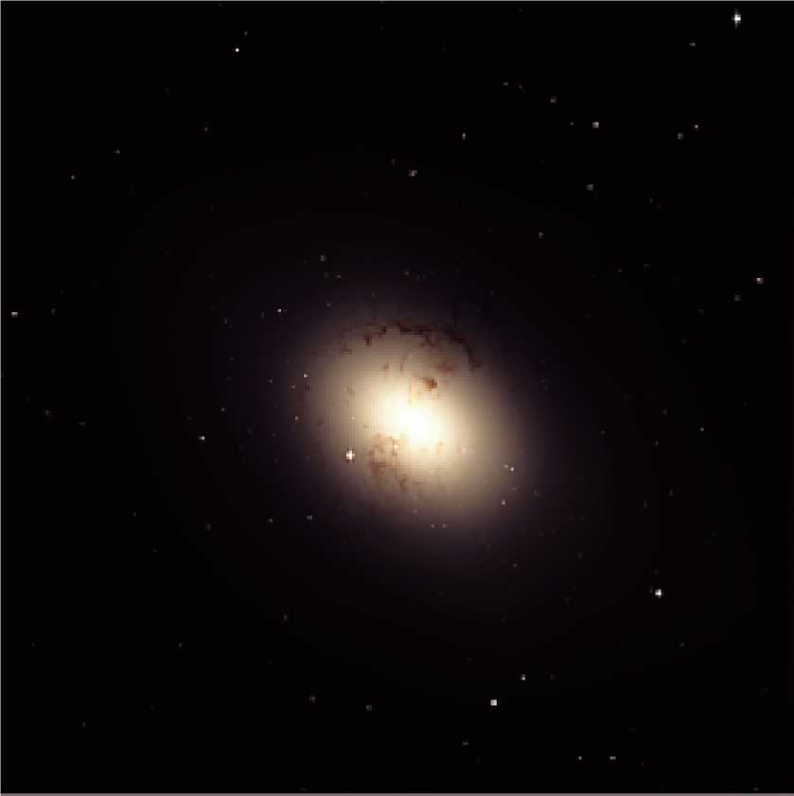
Elliptical Galaxy
Notes:
Makes no sense without caption in book

Slide 42
25.3 The Universe
Types of Galaxies
◆ Irregular Galaxies
• Only 10 percent of the known galaxies have irregular shapes and are classified as irregular galaxies.
• In addition to shape and size, one of the major differences among different types of galaxies is the age of their stars. Irregular galaxies contain young stars.
◆ Galaxy Clusters
• A galaxy cluster is a system of galaxies containing several to thousands of member galaxies.

Slide 43
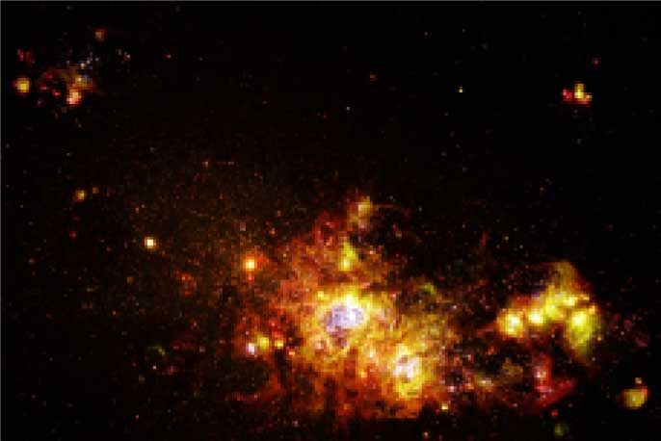
Irregular Galaxy
Notes:
Makes no sense without caption in book

Slide 44
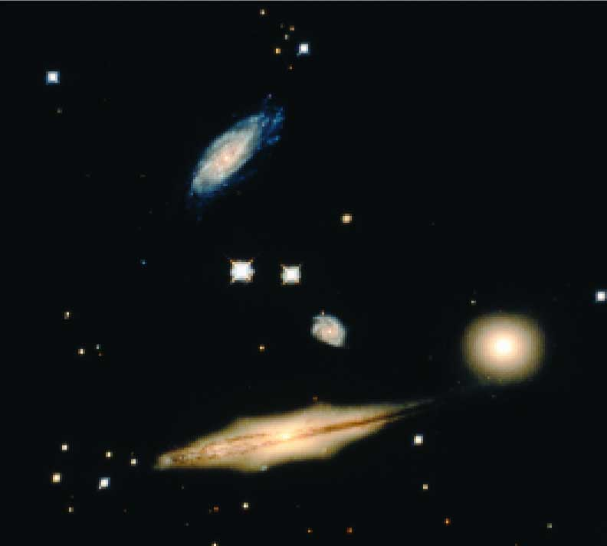
Galaxy Cluster
Notes:
Makes no sense without caption in book

Slide 45
25.3 The Universe
The Expanding Universe
◆ Red Shifts
• Red shift, or a Doppler shift toward the red end of the spectrum, occurs because the light waves are “stretched,” which shows that Earth and the source are moving away from each other.
◆ Hubble’s Law
• Hubble’s law is a law that states that the galaxies are retreating from the Milky Way at a speed that is proportional to their distance.
• The red shifts of distant galaxies indicate that the universe is expanding.

Slide 46
25.3 The Universe
The Expanding Universe
◆ Hubble’s Law
• To help visualize the nature of the universe, imagine a loaf of raisin bread dough that has been set out to rise for a few hours. As the dough doubles in size, so does the distance between all the raisins. Those objects located father apart move away from each other more rapidly.

Slide 47
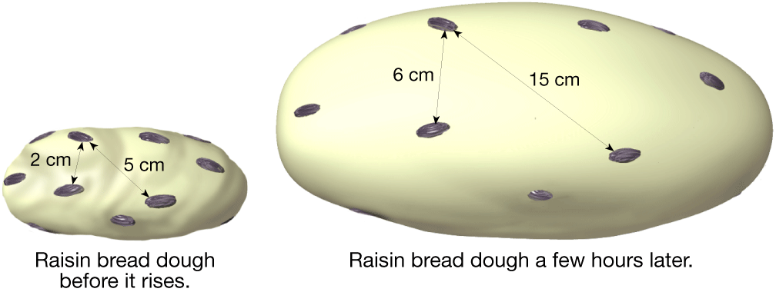
Raisin Bread Dough Analogy
Notes:
Makes no sense without caption in book

Slide 48
25.3 The Universe
The Big Bang
◆ The big bang theory states that at one time, the entire universe was confined to a dense, hot, supermassive ball. Then, about 13.7 billion years ago, a violent explosion occurred, hurling this material in all directions.

Slide 49
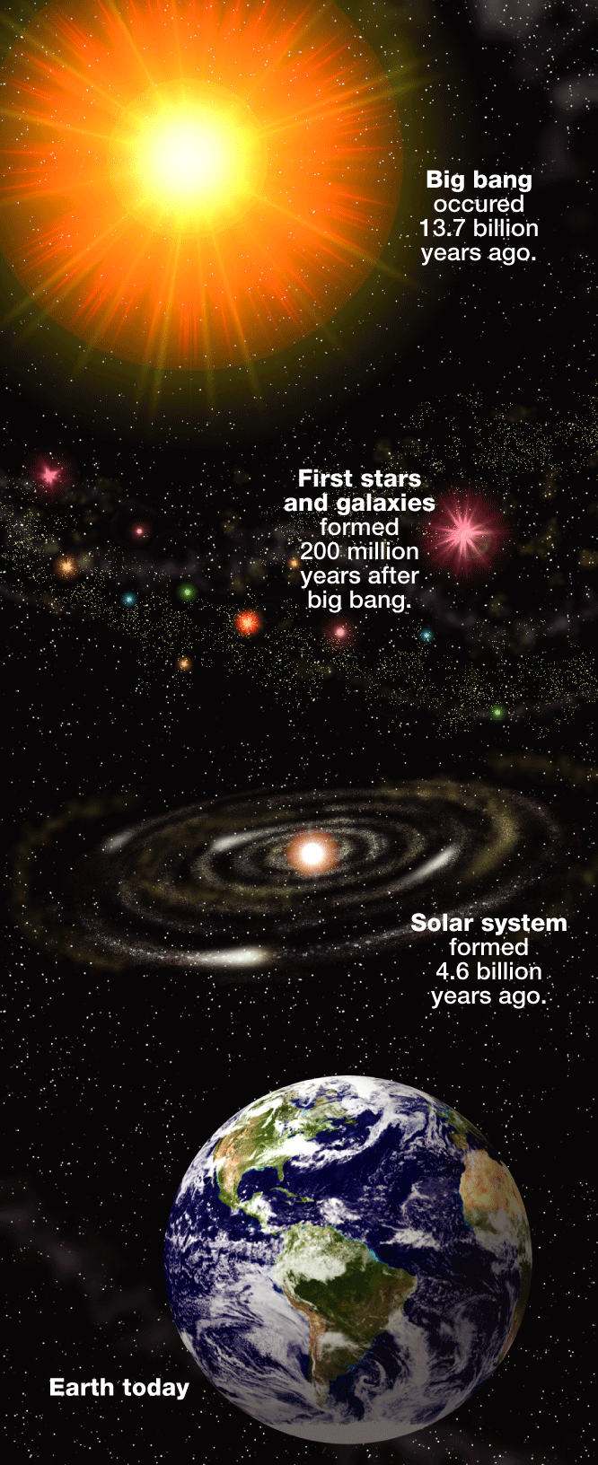
The Big Bang
Notes:
Makes no sense without caption in book

Slide 50
25.3 The Universe
The Big Bang
◆ Supporting Evidence
• The red shift of galaxies supports the big bang and the expanding universe theories.
• Scientists discovered a type of energy called cosmic background radiation. Scientists think that this radiation was produced during the big bang.

Slide 51
25.3 The Universe
The Big Bang
◆ The Big Crunch?
• The future of the universe follows two possible paths:
1. The universe will expand forever.
2. The outward expansion will stop and gravitational contraction will follow.
• The view currently favored by most scientists is an expanding universe with no ending point.
• It should be noted, however, that the methods used to determine the ultimate fate of the universe have substantial uncertainties.

