Slide 1
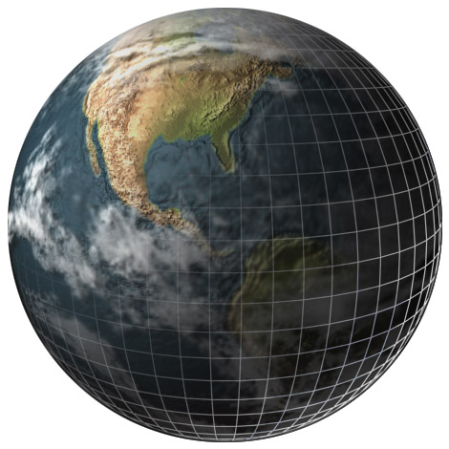
Prentice Hall EARTH SCIENCE
Tarbuck Lutgens
◆

Slide 2
Chapter 24
Studying the Sun
Notes:
Who is Stan Hatfield and Ken Pinzke

Slide 3
24.1 The Study of Light
Electromagnetic Radiation
◆ Electromagnetic radiation includes gamma rays, X-rays, ultraviolet light, visible light, infrared radiation, microwaves, and radio waves.
◆ The electromagnetic spectrum is the arrangement of electromagnetic radiation according to wavelength.

Slide 4
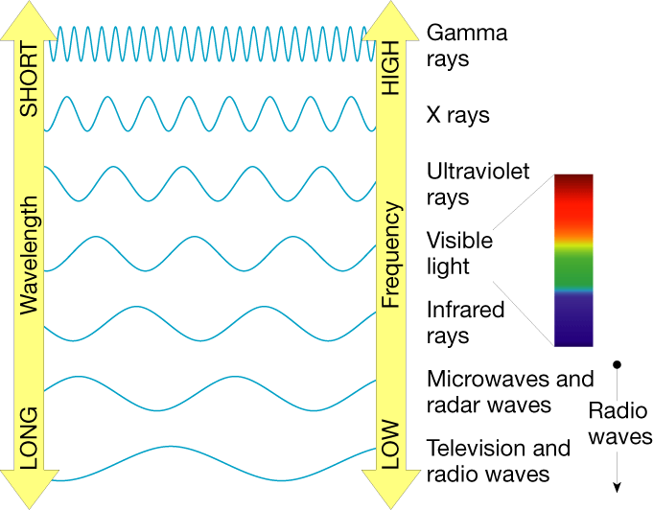
Electromagnetic Spectrum
Notes:
Makes no sense without caption in book

Slide 5
24.1 The Study of Light
Electromagnetic Radiation
◆ Nature of Light
• In some instances light behaves like waves, and in others, like particles. In the wave sense, light can be thought of as swells in the ocean. This motion is characterized by a property known as wavelength, which is the distance from one wave crest to the next.
◆ Photons
• A photon is a small packet of light energy.

Slide 6
24.1 The Study of Light
Spectroscopy
◆ Spectroscopy is the study of the properties of light that depend on wavelength.
◆ Continuous Spectrum
• A continuous spectrum is an uninterrupted band of light emitted by an incandescent solid, liquid, or gas under pressure.

Slide 7
24.1 The Study of Light
Spectroscopy
◆ Absorption Spectrum
• An absorption spectrum is a continuous spectrum produced when white light passes through a cool gas under low pressure. The gas absorbs selected wavelengths of light, and the spectrum looks like it has dark lines superimposed.

Slide 8
24.1 The Study of Light
Spectroscopy
◆ Emission Spectrum
• An emission spectrum is a series of bright lines of particular wavelengths produced by a hot gas under low pressure.
• When the spectrum of a star is studied, the spectral lines act as “fingerprints.” These lines identify the elements present and thus the star’s chemical composition.

Slide 9
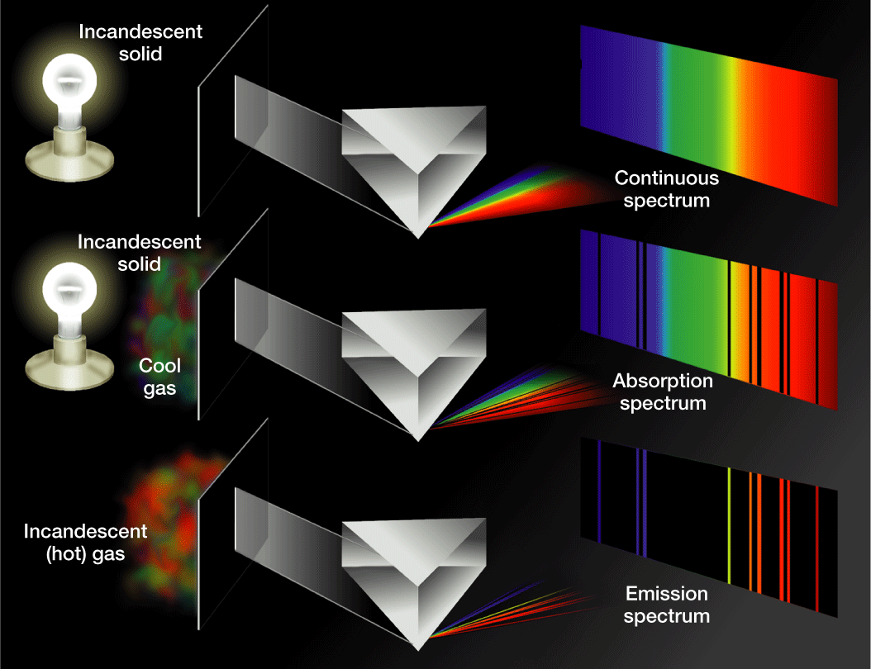
Formation of Spectra
Notes:
Makes no sense without caption in book

Slide 10
24.1 The Study of Light
The Doppler Effect
◆ The Doppler effect is the apparent change in frequency of electromagnetic or sound waves caused by the relative motions of the source and the observer.
◆ In astronomy, the Doppler effect is used to determine whether a star or other body in space is moving away from or toward Earth.

Slide 11
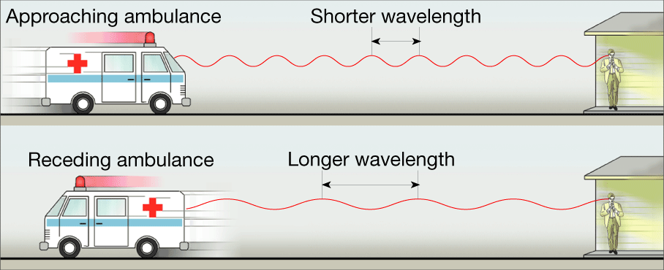
The Doppler Effect
Notes:
Makes no sense without caption in book

Slide 12
24.2 Tools for Studying Space
Refracting Telescopes
◆ A refracting telescope is a telescope that uses a lens to bend or refract light.
◆ Focus
• The most important lens in a refracting telescope, the objective lens, produces an image by bending light from a distant object so that the light converges at an area called the focus (focus = central point).

Slide 13
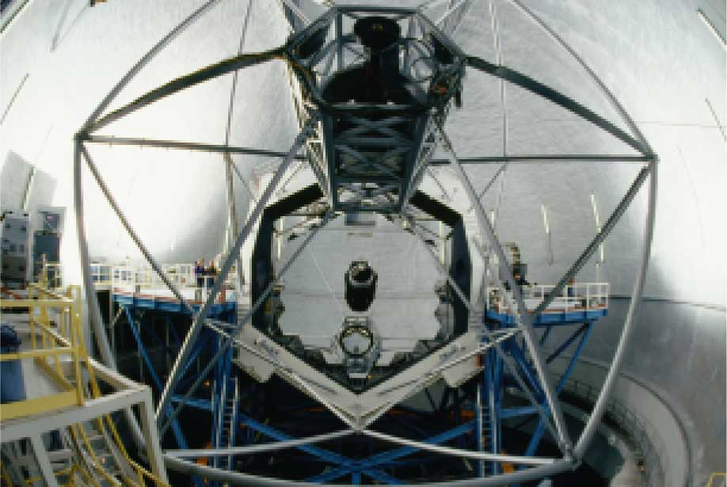
Keck Telescope
Notes:
Makes no sense without caption in book

Slide 14
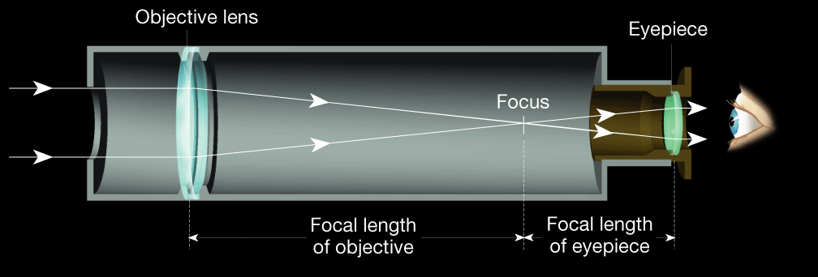
Simple Refracting Telescope
Notes:
Makes no sense without caption in book

Slide 15
24.2 Tools for Studying Space
Refracting Telescopes
◆ Chromatic Aberration
• A chromatic aberration is the property of a lens whereby light of different colors is focused at different places.

Slide 16
24.2 Tools for Studying Space
Reflecting Telescopes
◆ A reflecting telescope is a telescope that reflects light off a concave mirror, focusing the image in front of the mirror.
◆ Advantages of Reflecting Telescopes
• Most large optical telescopes are reflectors. Light does not pass through a mirror, so the glass for a reflecting telescope does not have to be of optical quality.

Slide 17
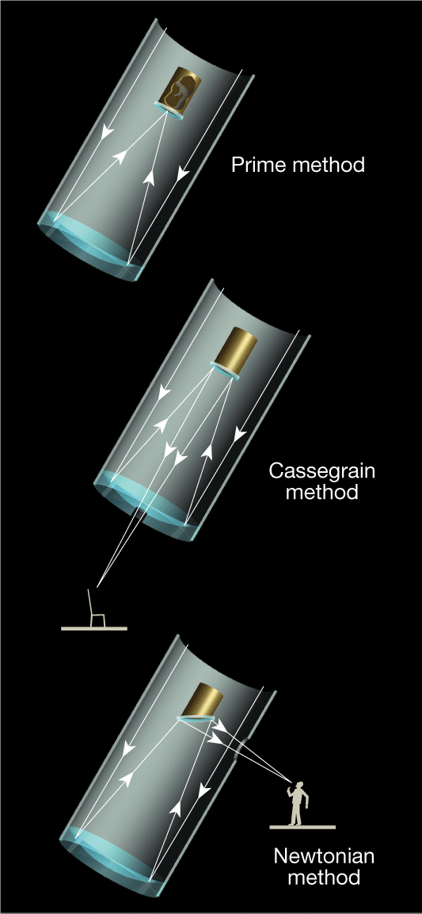
Viewing Methods with Reflecting Telescopes
Notes:
Makes no sense without caption in book

Slide 18
24.2 Tools for Studying Space
Reflecting Telescopes
◆ Properties of Optical Telescopes
• Both refracting and reflecting telescopes have three properties that aid astronomers in their work:
1. Light-gathering power
2. Resolving power
3. Magnifying power

Slide 19
24.2 Tools for Studying Space
Detecting Invisible Radiation
◆ Radio Telescopes
• A radio telescope is a telescope designed to make observations in radio wavelengths.
• A radio telescope focuses the incoming radio waves on an antenna, which, just like a radio antenna, absorbs and transmits these waves to an amplifier.

Slide 20
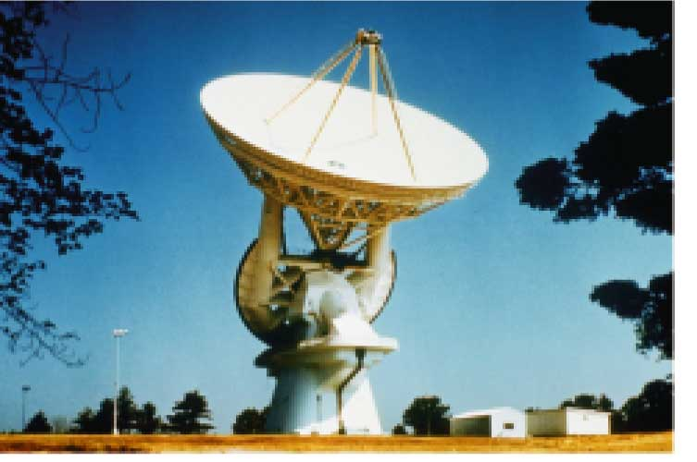
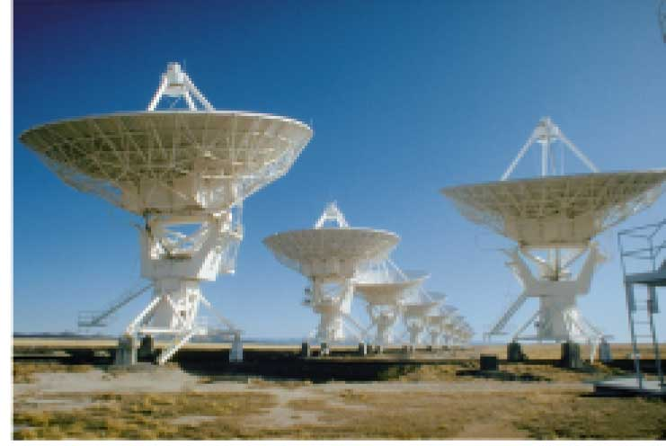
Radio Telescopes
Notes:
Makes no sense without caption in book

Slide 21
24.2 Tools for Studying Space
Detecting Invisible Radiation
◆ Advantages of Radio Telescopes
• Radio telescopes are much less affected by turbulence in the atmosphere, clouds, and the weather.
• No protective dome is required, which reduces the cost of construction.
• Radio telescopes can “see” through interstellar dust clouds that obscure visible wavelengths.

Slide 22
24.2 Tools for Studying Space
Space Telescopes
◆ Space telescopes orbit above Earth’s atmosphere and thus produce clearer images than Earth-based telescopes.
◆ Hubble Space Telescope
• The first space telescope, built by NASA, was the Hubble Space Telescope. Hubble was put into orbit around Earth in April 1990.

Slide 23
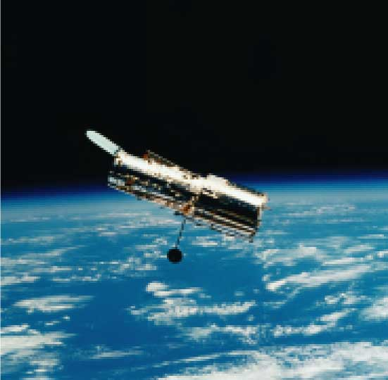
Hubble Space Telescope
Notes:
Makes no sense without caption in book

Slide 24
24.2 Tools for Studying Space
Space Telescopes
◆ Other Space Telescopes
• To study X-rays, NASA uses the Chandra X-Ray Observatory. This space telescope was launched in 1999.
• Another space telescope, the Compton Gamma-Ray Observatory, was used to study both visible light and gamma rays.
• In 2011, NASA plans to launch the James Webb Space Telescope to study infrared radiation.

Slide 25
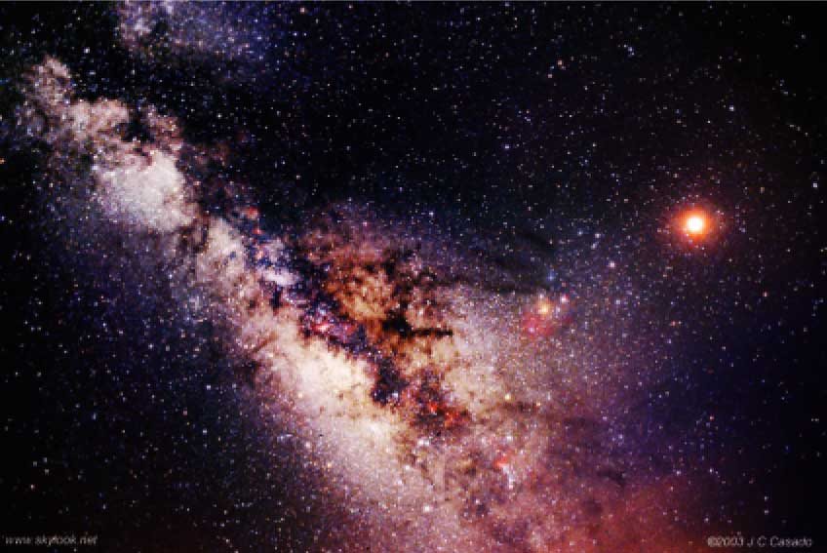
Images of the Milky Way Galaxy
Notes:
Makes no sense without caption in book

Slide 26
24.3 The Sun
Structure of the Sun
◆ Because the sun is made of gas, no sharp boundaries exist between its various layers. Keeping this in mind, we can divide the sun into four parts: the solar interior; the visible surface, or photosphere; and two atmospheric layers, the chromosphere and corona.

Slide 27
24.3 The Sun
Structure of the Sun
◆ Photosphere
• The photosphere is the region of the sun that radiates energy to space, or the visible surface of the sun.
• It consists of a layer of incandescent gas less than 500 kilometers thick.
• It exhibits a grainy texture made up of many small, bright markings, called granules, produced by convection.
• Most of the elements found on Earth also occur on the sun.
• Its temperature averages approximately 6000 K (10,000ºF).

Slide 28
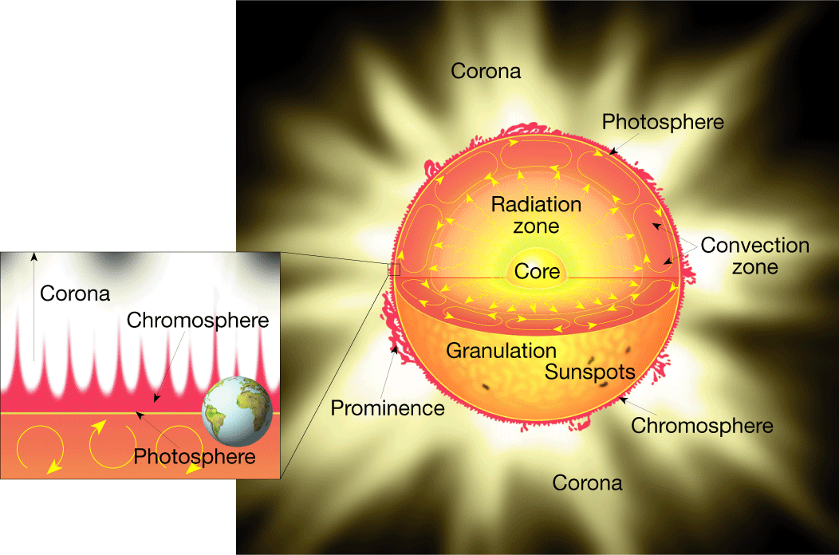
Structure of the Sun
Notes:
Makes no sense without caption in book

Slide 29
24.3 The Sun
Structure of the Sun
◆ Chromosphere
• The chromosphere is the first layer of the solar atmosphere found directly above the photosphere.
• It is a relatively thin, hot layer of incandescent gases a few thousand kilometers thick.
• Its top contains numerous spicules, which are narrow jets of rising material.

Slide 30
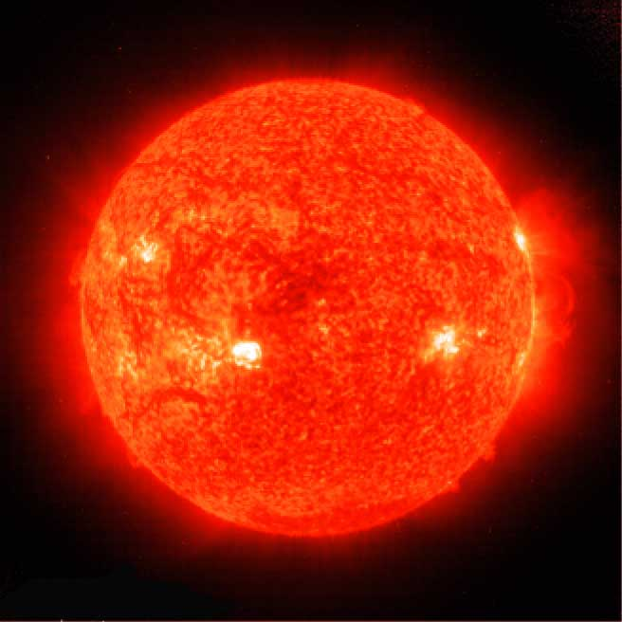
Chromosphere
Notes:
Makes no sense without caption in book

Slide 31
24.3 The Sun
Structure of the Sun
◆ Corona
• The corona is the outer, weak layer of the solar atmosphere.
• The temperature at the top of the corona exceeds 1 million K.
• Solar wind is a stream of protons and electrons ejected at high speed from the solar corona.

Slide 32
24.3 The Sun
The Active Sun
◆ Sunspots
• A sunspot is a dark spot on the sun that is cool in contrast to the surrounding photosphere.
• Sunspots appear dark because of their temperature, which is about 1500 K less than that of the surrounding solar surface.

Slide 33
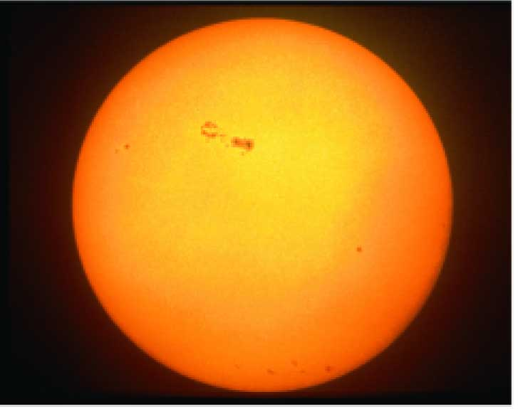
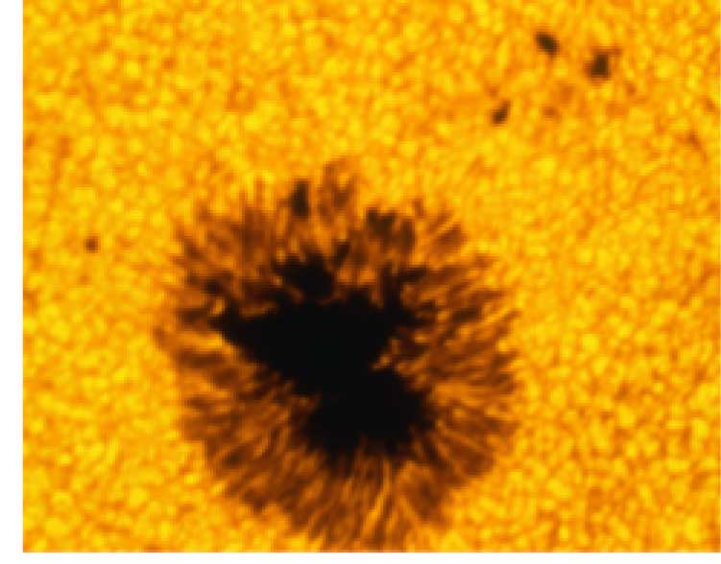
Sunspots
Notes:
Makes no sense without caption in book

Slide 34
24.3 The Sun
The Active Sun
◆ Prominences
• Prominences are huge cloudlike structures consisting of chromospheric gases.
• Prominences are ionized gases trapped by magnetic fields that extend from regions of intense solar activity.

Slide 35
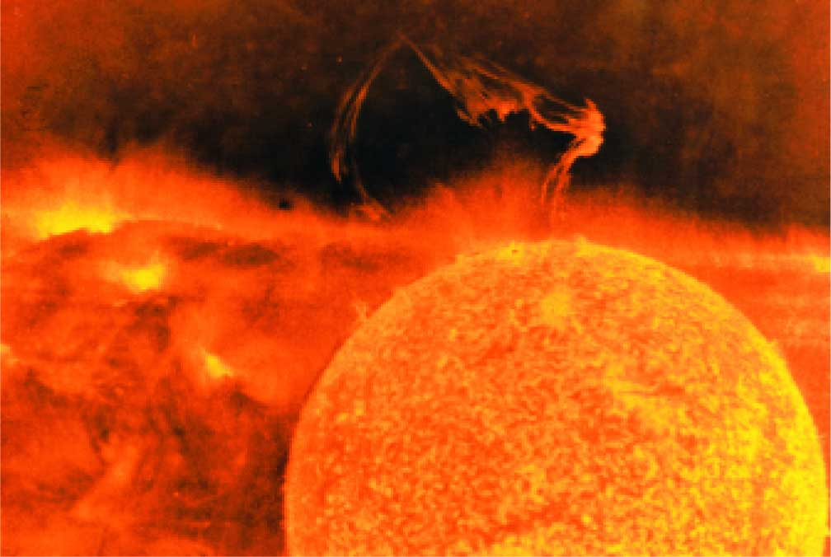
Solar Prominence
Notes:
Makes no sense without caption in book

Slide 36
24.3 The Sun
The Active Sun
◆ Solar Flares
• Solar flares are brief outbursts that normally last about an hour and appear as a sudden brightening of the region above a sunspot cluster.
• During their existence, solar flares release enormous amounts of energy, much of it in the form of ultraviolet, radio, and X-ray radiation.
• Auroras, the result of solar flares, are bright displays of ever-changing light caused by solar radiation interacting with the upper atmosphere in the region of the poles.

Slide 37
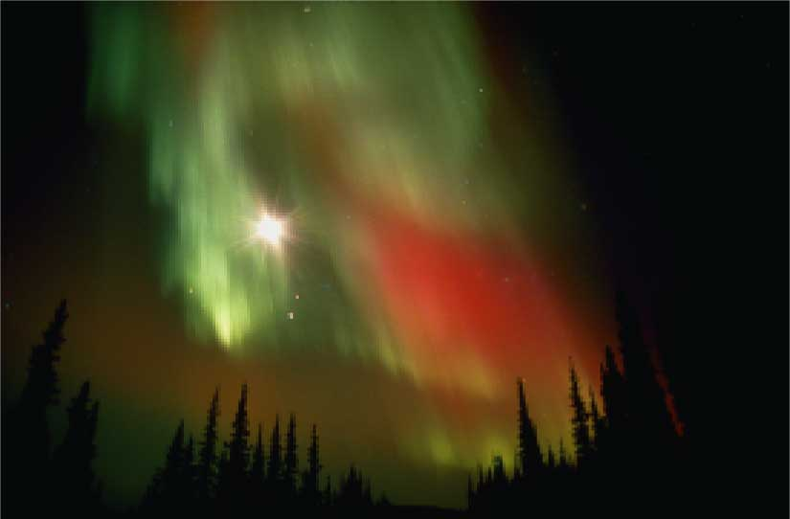
Aurora Borealis
Notes:
Makes no sense without caption in book

Slide 38
24.3 The Sun
The Solar Interior
◆ Nuclear Fusion
• Nuclear fusion is the way that the sun produces energy. This reaction converts four hydrogen nuclei into the nucleus of a helium atom, releasing a tremendous amount of energy.
• During nuclear fusion, energy is released because some matter is actually converted to energy.
• It is thought that a star the size of the sun can exist in its present stable state for 10 billion years. As the sun is already 4.5 billion years old, it is “middle-aged.”

Slide 39
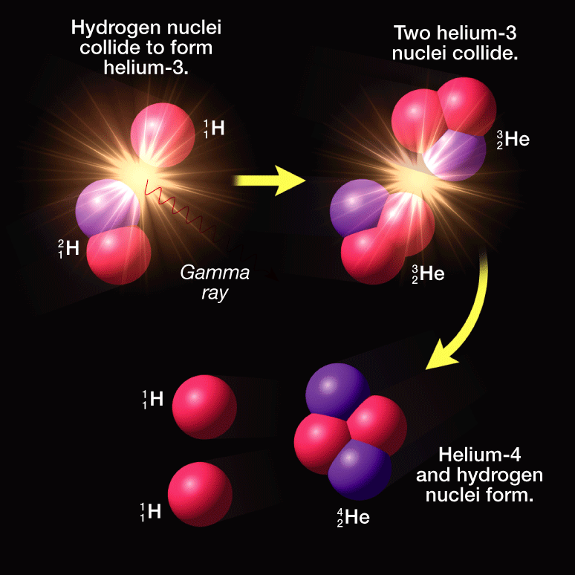
Nuclear Fusion
Notes:
Makes no sense without caption in book

