Slide 1
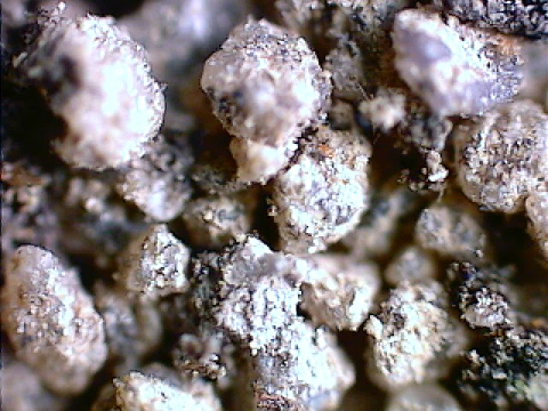
Soils:
One of Our
Natural Resources!

Slide 2
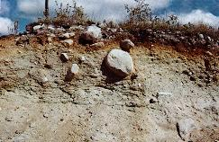
Some call it dirt…..But it is Soil !!!
Soil is made of loose, weathered rock and organic material.

Slide 3
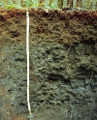
The rock material in soil contains three noticeable parts: sand, clay, and silt.

Slide 4
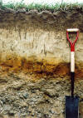
Soil, on the average, consists of 45% mineral, 25% water, 25% air and 5% organic matter.
This is just an average!

Slide 5
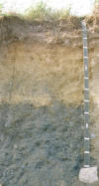
There are thousands of different soils throughout the world.
Five important factors influence the specific soil that develops.

Slide 6
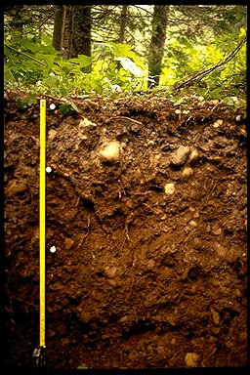
Parent Material
This refers to the minerals and organic materials present during the soil’s formation.

Slide 7
Parent Material
Materials from volcanoes, sediment transported by wind, water, or glaciers are some examples.

Slide 8
Question Break!

Slide 9
Think about the soils in our area. Where do you think our “parent material” came from?

Slide 10
Our parent material is mainly Marine sediment (ocean in origin), or produced by steam-river action.
It may be thousands of feet deep!

Slide 11
Climate
The climate of a particular region can have a major influence on the rate of soil formation.

Slide 12
Climate
Weathering processes like the cycles of freezing and thawing, along with wetting and drying vary with each region.

Slide 13
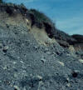
Living Organisms
Both plants and animals help create soil.

Slide 14
Living Organisms
As they die, organic matter incorporates with weathered parent material and becomes part of the soil.

Slide 15
Question Break!

Slide 16
Can you think of some organisms that might help mix and enrich the soil?

Slide 17
Living Organisms
The actions of moles, earthworms, bacteria, fungi, and round worms mix and enrich the soil.

Slide 18
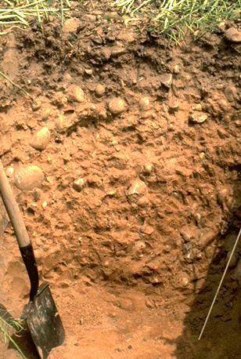
Topography
The slope or hilliness of a region can have a major influence on the moisture and erosion of soils.

Slide 19
Topography
In many regions, moist, poorly drained soils are located in low areas.

Slide 20
Topography
Drier, well drained soils are often found in sloping hillsides. Erosion is often a problem here and can lead to lose of topsoil.

Slide 21
Time
It takes hundreds of years to form one inch of soil from parent material.

Slide 22
Time
Only the top few centimeters are productive in the sense of being able to sustain plant growth.

Slide 23
Time
This is why soil conservation is so important!

Slide 24
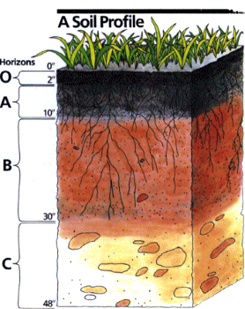
Soil Profile
In a cross-section of soil, various zones are formed.

Slide 25
O Horizon: Organic Layer
It consists of leaf litter and other organic material lying on the surface of the soil.

Slide 26
A Horizon: Topsoil
This layer is usually loose and crumbly with varying amounts of organic matter.

Slide 27
A Horizon: Topsoil
This is generally the most productive layer of the soil.
Conservation efforts are focused here!

Slide 28
B Horizon: Subsoils
Subsoils are usually lighter in color, dense and low in organic matter.

Slide 29
C Horizon: Transition
This layer of transition is almost completely void of organic mater and is made up of partially weathered parent material.

Slide 30
Bedrock
Below the C horizon the unweathered bedrock will be found.

Slide 31
Last Question!

Slide 32
What would happen to land based life as we know it, if there was no soil layer?

