Slide 1
Weathering
& Erosion

Slide 2
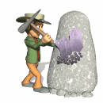
Weathering is the break-up of rock due to exposure to the atmosphere.

Slide 3
Weathering involves two processes that often work together to decompose or break down rocks.

Slide 4
Chemical and Mechanical Weathering!

Slide 5
Chemical
Chemical weathering, or decomposition, takes place when at least some of the rock’s minerals are changed into different substances.

Slide 6
Chemical
Chemical processes include rain, acid etching by plants, oxidizing, and demineralizing by water.

Slide 7
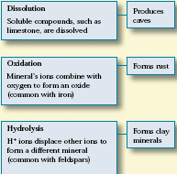
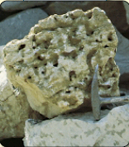
Chemical
Weathering

Slide 8
Mechanical
Mechanical weathering, or disintegration, involves physically breaking rocks into fragments without changing the chemical make-up of the minerals within them.

Slide 9
There are four main sources of power for mechanical weathering.
Gravity, Water, Wind, & Waves
Of these, water appears to be the leader in changing the surface.

Slide 10
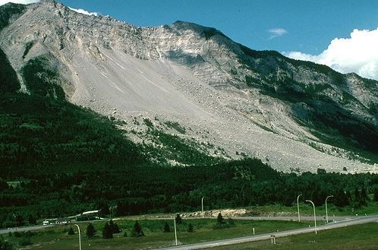
If a particle is loosened by weathering, but stays put, its just weathering. If it starts moving, its Erosion.
Remember this!: You’ll be quizzed soon!
Key Point!

Slide 11
Mechanical weathering processes, many of which are erosional, include some of the following.

Slide 12
Frost Wedging
Frost Wedging is the freezing and thawing of water in cracks.

Slide 13
Mechanical Exfoliation
Mechanical Exfoliation is the peeling off of sheets of rock as they expand and crack.

Slide 14
Crystal Growth Wedging
Crystal Growth Wedging involves salt crystals growing from salty waters.

Slide 15
Crystal Growth Wedging
Crystal Growth Wedging usually occurs near coastlines as it has on this granite.

Slide 16
Root Penetration
Plant roots have to be strong to survive the elements.

Slide 17
Root Penetration
Powerful plant roots grow into rock cracks and cause fractures.

Slide 18
Abrasion
Both wind and water can cause abrasion as rock fragments bounce off each other.

Slide 19
Abrasion
This “moon looking” picture of an Antarctic rock, shows weathering from the wind blown sands.

Slide 20
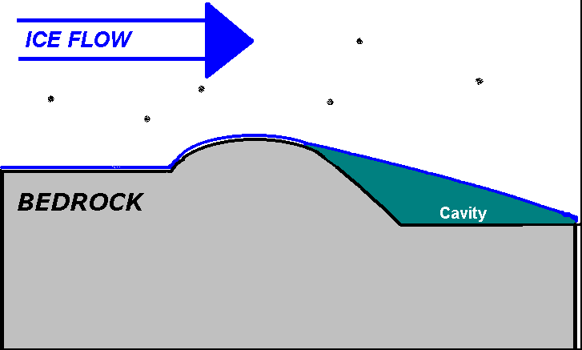
Glacial Weathering
Glaciers and avalanches can cause weathering as ice and rock interact.

Slide 21
Other Agents of Weathering
Things like flash floods, mud slides, landslides, and other forms of mass wasting can cause weathering.

Slide 22
Erosion
Remember: Erosion involves removal and transport.

Slide 23
Erosion
Rain, wind, and streams are all agents of erosion.
Can you think of any others?

Slide 24
Quiz Time!
Get out a piece of paper and identify if the following involve weathering, erosion, both, or neither.

Slide 25
Ready?
1.Waves are crashing on a sand beach.
2.Water expands as it freezes in the cracks of rocks.
3. Pebbles move down a stream with the current.

Slide 26
4. Acid rain causes the decomposition of a statue in New York.
5. A man shovels dirt to plant a tree.
6. A Glacier slowly moves down a mountain.
7. A tree’s roots grow into the cracks of rocks.
8. A major volcano erupts.

Slide 27
9. A boy takes out the garbage for his mother.
10. A shovel is left outside and begins to rust.
Once you’ve answered these, discuss you’re answers with the rest of the class before you go on.

Slide 28
Let’s Discuss The Questions.
1. As the sand is moving there is definitely erosion; there is also abrasion from the sand gains colliding. Both

Slide 29
2. This is frost wedging so it’s mechanical weathering. There is no mention of movement. Weathering

Slide 30
3. There is probably some weathering, but there is definitely erosion. Erosion or Both

Slide 31
4. Acid rain on a statue is chemical weathering. This is mainly Weathering.

Slide 32
5.Since the man is transporting Earth materials, it’s Erosion.

Slide 33
6. A glacier moving down a mountain would have both weathering and erosion. Both

Slide 34
7. A tree’s roots growing into cracks of rocks would be weathering. Weathering

Slide 35
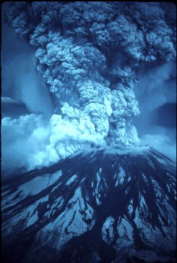
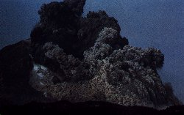
8. A major volcanic eruption would involve both weathering and erosion. Both

Slide 36
9. Unless the garbage has “Earth Material” or dirt in it there is probably no erosion or weathering. Neither

Slide 37
10. The rusting of a shovel is oxidation. This is chemical weathering. Weathering
Think you understand the difference?

